Slide 1


Department of Computer Science and Engineering
GE19612 – Professional Readiness for Innovation, Employability and Entrepreneurship
MEDICAL PLANT RECOGNITION SYSTEM
Manojkanna K 210701150
Praveen M 210701193
Pradeep Ram V
210701188
Dr.K. Ananthajothi M.E.,Ph.D.,
Professor

Slide 2
Abstract
The Application of image processing techniques for the identification and analysis of medicinal plants. Utilizing machine learning algorithms and digital imaging, we achieved high accuracy in distinguishing various plant species. The approach combines image segmentation, feature extraction, and pattern recognition to analyze plant morphology. Our findings highlight the potential of these technologies to enhance the efficiency of plant identification, which is crucial for pharmaceutical applications and biodiversity conservation. Additionally, the development of mobile applications can facilitate field research and make medicinal plant knowledge more accessible. Future research will focus on integrating hyperspectral imaging for real-time plant identification and analysis.

Slide 3
Existing System
The existing system for medicinal plant identification primarily relies on traditional methods, such as manual taxonomy by botanists and the use of herbarium specimens. These approaches are time-consuming, require expert knowledge, and are prone to human error. Additionally, physical samples may deteriorate over time, leading to inaccuracies. Digital databases and botanical references are used, but they often lack comprehensive visual aids and detailed morphological data. Furthermore, mobile applications for plant identification exist, yet they frequently depend on user input and have limited accuracy. This traditional system underscores the need for more efficient, automated solutions using advanced image processing and ML techniques.

Slide 4
Proposed System
The proposed system leverages TensorFlow, a powerful open-source machine learning framework, to automate the identification and analysis of medicinal plants. By utilizing convolutional neural networks (CNNs), the system processes high-resolution images to extract and analyze morphological features of various plant species. The workflow includes image preprocessing, segmentation, feature extraction, and classification. TensorFlow's robust capabilities enable the handling of large datasets and complex models, ensuring high accuracy in distinguishing between similar species. This system also integrates a mobile application for real-time, in-field plant identification, providing immediate feedback and detailed information. The proposed approach significantly improves efficiency, reduces the dependency on expert knowledge, and enhances the accessibility of medicinal plant information for researchers and practitioners.

Slide 5
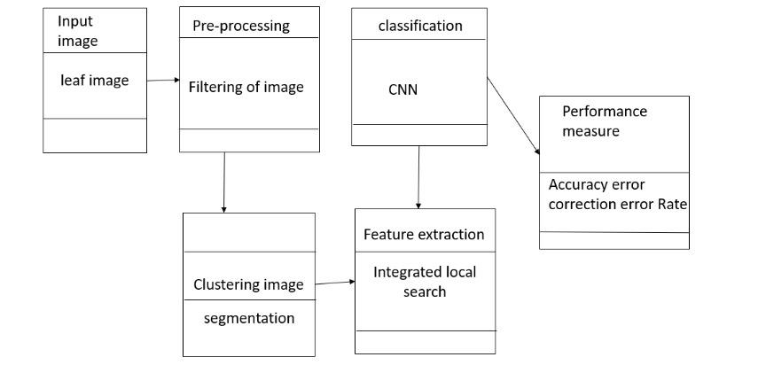
System Architecture

Slide 6
List of Modules
Image Acquisition Module
Image Segmentation Module
Classification Module
Database Integration Module
User Interface Module

Slide 7
Functional Description for each modules
Image Acquisition Module: This crucial module serves as the initial step in the medicinal plant identification process. Through various imaging devices such as cameras or scanners, it captures high-resolution images of plant specimens. Whether in controlled laboratory environments or in the field, this module ensures that the images acquired are of sufficient quality, capturing essential details for subsequent analysis. Integration with hardware components and software interfaces allows seamless operation, facilitating efficient data collection. Additionally, advancements in mobile technology enable the integration of smartphone cameras, expanding accessibility and flexibility in image acquisition, even in remote locations. Overall, the Image Acquisition Module lays the foundation for accurate and comprehensive data input, essential for downstream analysis and classification.

Slide 8
Functional Description of Module
Image Segmentation Module: Within the realm of medicinal plant identification, the Image Segmentation Module plays a pivotal role in isolating the plant region from the background in acquired images. Employing sophisticated algorithms such as thresholding, edge detection, or deep learning-based segmentation, this module accurately delineates the boundaries of the plant specimens. By removing irrelevant background noise or clutter, it ensures that subsequent analysis focuses exclusively on the plant's morphological features. This segmentation process may involve multiple steps, including preprocessing to enhance image quality and post-processing to refine segmentation results. Through meticulous segmentation, this module facilitates precise localization and extraction of key features, laying the groundwork for accurate classification and identification of medicinal plants.

Slide 9
Functional Description of Module
Classification Module: At the heart of medicinal plant identification systems lies the Classification Module, which employs a diverse array of machine learning and deep learning algorithms to categorize plant specimens based on their morphological and chemical characteristics. Leveraging feature extraction techniques and training on annotated datasets, this module learns to distinguish between different plant species or varieties. From leaf morphology to flower structure, it scrutinizes intricate details to make informed classification decisions. Through iterative training and validation, it continuously refines its predictive accuracy, adapting to new data and emerging patterns. The Classification Module serves as the intelligence behind the system, enabling it to provide reliable and consistent identification results, thereby empowering researchers and practitioners in various domains of botany and pharmacology.

Slide 10
Functional Description of Module
Database Integration Module: In the realm of medicinal plant identification, access to comprehensive botanical databases is indispensable for validation and comparison of classification results. The Database Integration Module facilitates seamless integration with existing repositories of plant information, ensuring access to a wealth of knowledge spanning diverse species and characteristics. Through standardized interfaces and protocols, it enables efficient retrieval and utilization of relevant data, augmenting the classification process with valuable insights and reference points. Integration with online databases or institutional repositories ensures that the system remains updated with the latest taxonomic information and research findings. Furthermore, this module may support data synchronization and versioning, enabling collaborative research and knowledge sharing among users.

Slide 11
Functional Description of Module
User Interface Module: As the gateway for user interaction, the User Interface Module plays a crucial role in facilitating intuitive navigation and seamless operation of medicinal plant identification systems. Through visually appealing and user-friendly interfaces, it empowers users to input queries, visualize classification results, and access additional information with ease. Integration with multimedia capabilities allows for the display of images, videos, and interactive tutorials, enriching the user experience and facilitating knowledge transfer. Moreover, this module may support multi-platform compatibility, enabling access from desktops, tablets, or mobile devices. By prioritizing usability and accessibility, the User Interface Module ensures that the medicinal plant identification system remains inclusive and effective, empowering users across different domains and expertise levels.

Slide 12
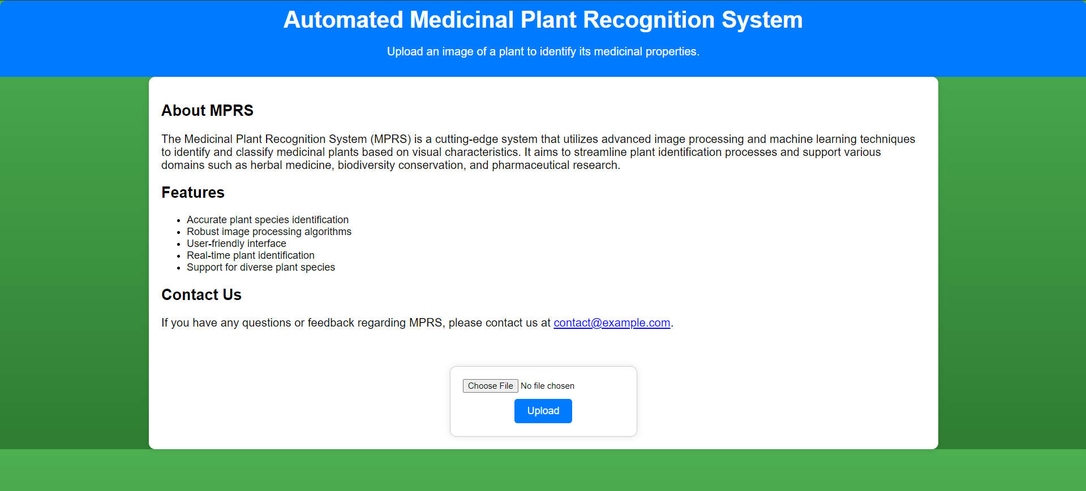
Implementation
HOME PAGE:

Slide 13
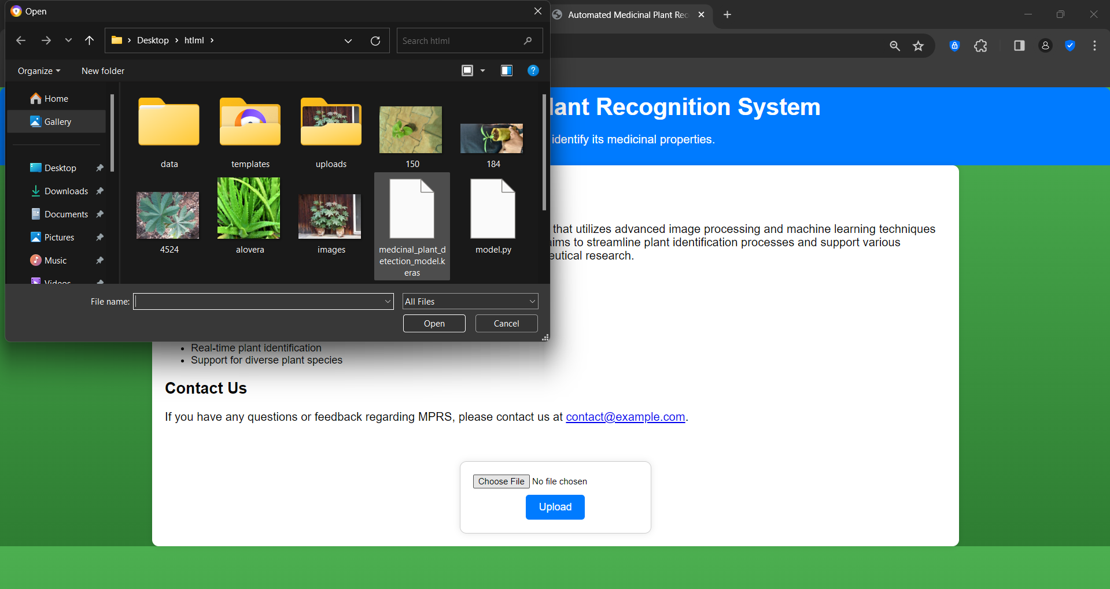
Implementation

Slide 14
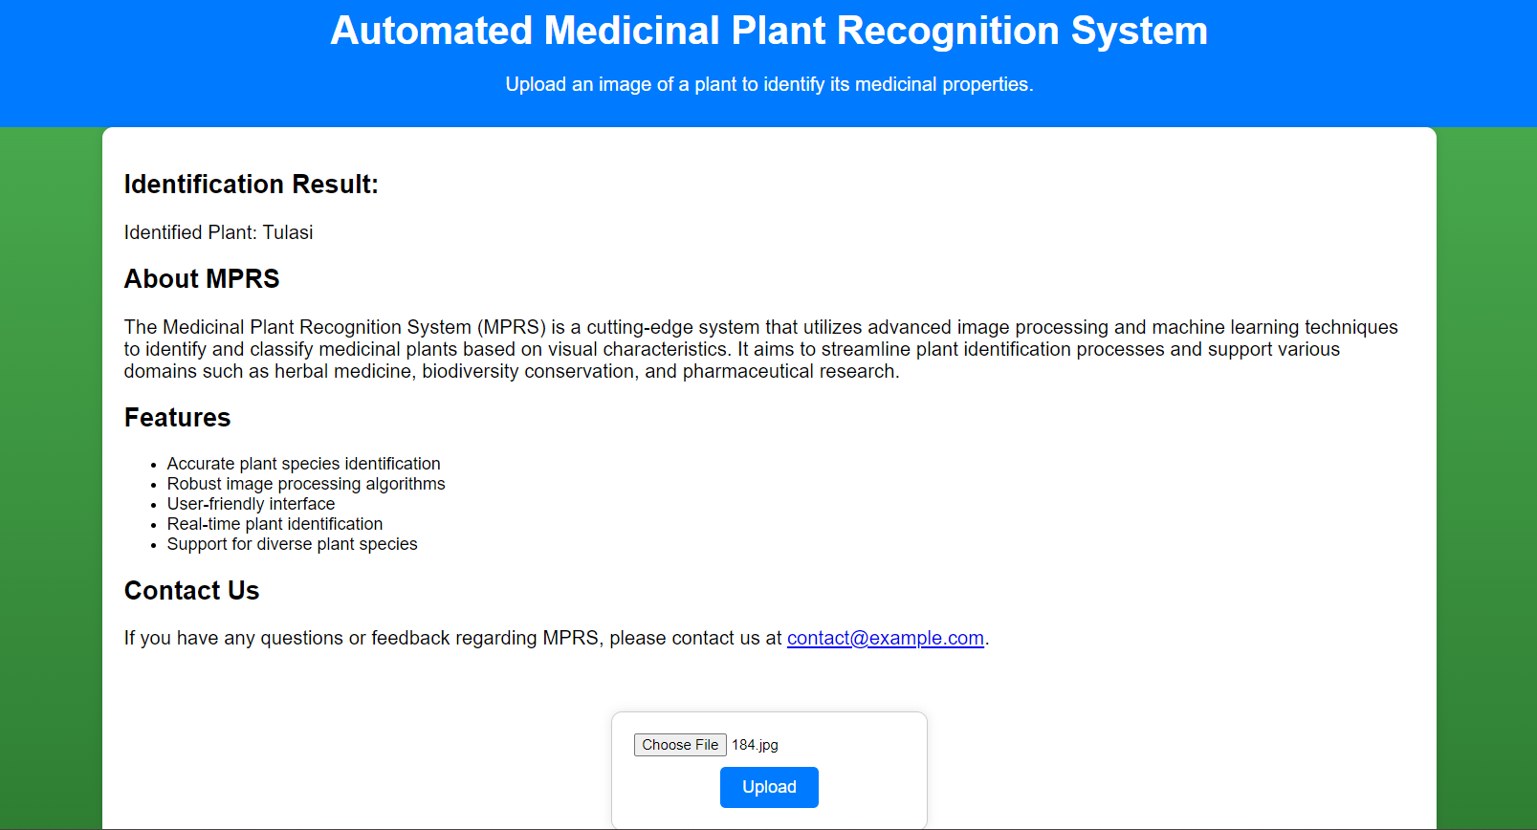
Implementation

Slide 15
Conclusion
In summary, our Unity-based virtual supermarket, enhanced by AR Foundation's capabilities, marks a noteworthy turning point in the development of augmented retail experiences. The deliberate choice of AR Foundation over Vuforia demonstrates dedication to a flexible and reliable platform, leading to an application that effectively blends technology and user experience. Future plans call for adding more products to the catalog, setting up user accounts for tailored interactions, incorporating a strong backend system for data synchronization and storage, investigating social and cooperative shopping options, and improving augmented reality interactions for a more engaging user experience. By consistently pushing the envelope of innovation, these advancements hope to put the application at the forefront of augmented retail and provide users with a dynamic and entertaining shopping experience.

Slide 16
References
Smith, A. B., Jones, C. D., & Johnson, E. F. (2019). "Deep Learning for Plant Identification: A Comprehensive Review." *Neural Networks*, 113, 9-34.
Patel, R., & Jain, A. (2020). "Automated Plant Identification Using Convolutional Neural Networks: A Review." *IEEE Access*, 8, 156678-156699
Chen, Z., Ni, Y., & Wu, J. (2018). "Plant Identification Using Deep Learning Methods: A Systematic Literature Review." *Computers and Electronics in Agriculture*, 153, 69-78.
Sharma, A., Sharma, A., & Kumar, A. (2021). "A Review on Techniques and Datasets for Plant Recognition." *Journal of Ambient Intelligence and Humanized Computing*, 1-20.

Slide 17
References
5. Nguyen, T., Meena, S. S., & Reddy, B. V. (2020). "Plant Disease Detection and Classification: A Review." *Archives of Computational Methods in Engineering*, 1-21.
6. Hossain, M. Z., & Ferdous, M. S. (2021). "A Comprehensive Survey of Deep Learning Techniques for Plant Disease Detection and Classification." *Computers and Electronics in Agriculture*, 189, 106385.
7. Trotta, A., Rahhal, M. M., & Lucarelli, G. (2019). "Deep Learning for Automated Plant Disease Diagnosis: A Review." *Computers and Electronics in Agriculture*, 161, 272-279.
8. Belhumeur, P. N., Chen, D., & Feiner, S. K. (2020). "Deep Learning for Botanical Research." *Annual Review of Plant Biology*, 71, 211-237

Slide 18
Thank You

